Slide 1
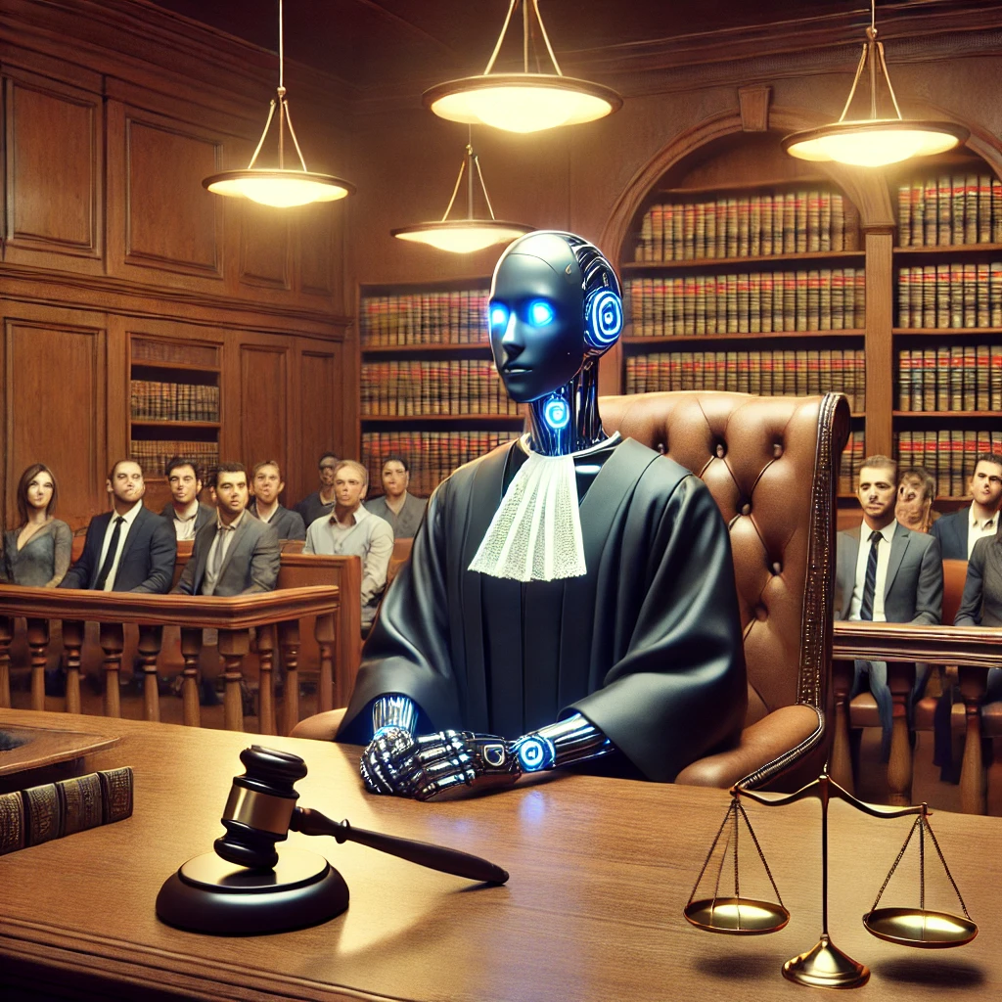
DEVELOP AN
AI JUDGE WITH NLP AND ML
SIDDHESH JADHAV
MSC DATA ANALYTICS
2023-2024

Slide 2
3
Aim & Methods
5
Conclusion
1
Introduction
1
Introduction
4
Results
Background and context
2

Slide 3

INTRODUCTION
Justice Delayed
Is Justice Denied.
- William Gladstone (1868)

Slide 4
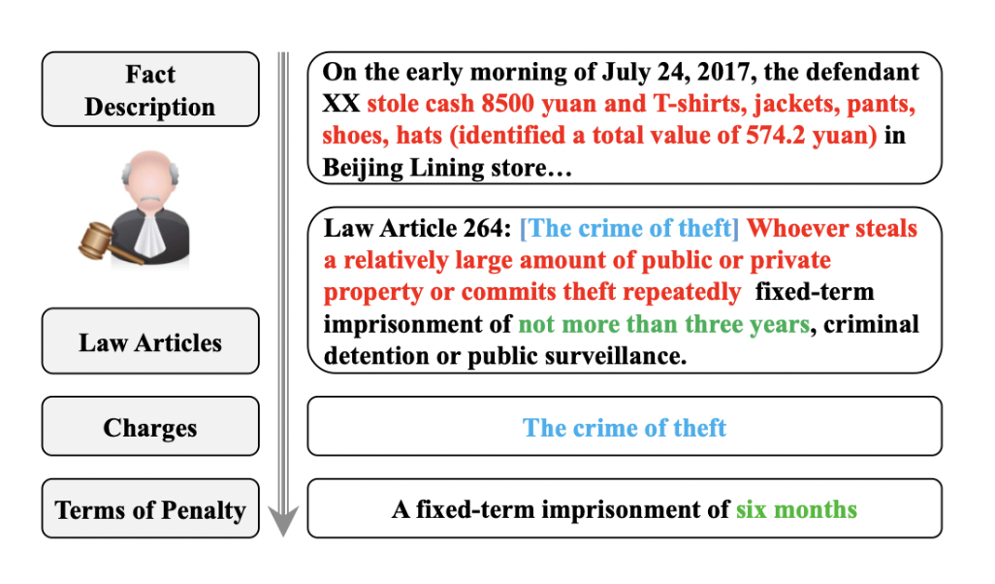
Fig: An illustration of human judges’ judicial decisions in the civil law system
source: https://aclanthology.org/D18-1390

Slide 5
BACKGROUND
AND
CONTEXT

Slide 6
LEGAL JUDGMENT PREDICTION
It's the task of using technology to predict the outcome of legal cases based on the facts presented in the case documents.
It helps in understanding and analyzing legal decisions, potentially improving the efficiency of legal processes.
Can assist lawyers, judges, and legal researchers in making more informed decisions.

Slide 7

AIM
&
METHODS
Aim of the project is how Legal Judgment Prediction can be improved using Small Language Models.

Slide 8

Methods
Pre-trained Language Model: A pre-trained language model is an AI trained on large text datasets from different sources like books, Wikipedia and etc. to understand and generate human language, allowing it to perform various NLP tasks.
Fine-Tuning a Pre-trained Model: Fine-tuning involves further training a pre-trained language model on a specific, smaller dataset.
LexGLUE: a benchmark dataset to evaluate the performance of NLP methods in legal tasks. LexGLUE is based on existing legal NLP datasets, which contains 8 different datasets within for tasks like Q&A, multi-label classification and multi-class classification.

Slide 9
Task Type: Multi-Label Sequence Classification: The task involves multi-label classification, where the model must predict multiple possible labels (i.e., ECHR articles) if any violated from a case description, showcasing its capability to handle complex legal scenarios with multiple violations.
Example of training data; LexGLUE (ECTHR Task A)
Case Description | Label
The applicant was born in 1904 and lived in Warsaw. He was the co-owner of a plot of land and a house in Warsaw.", "9. On 23 September 1980 G.G., one of the co-owners (“the petitioner”) filed with the Warsaw-Praga District Court (Sąd Rejonowy) an application for division of the property.", "10. On 2 August 1984 the District Court gave a decision and divided the property. On 21 January 1985, on the applicant’s appeal, the Warsaw Regional Court (Sąd Wojewódzki) quashed the decision and remitted the case to the District Court.", "11. On 24 September 1986, at the request of the petitioner, the District Court issued an interim order enjoining third parties from entering the attic of the house. On 27 May 1988 the court issued another interim order enjoining the applicant and his wife from carrying out any work to the house. On 24 November 1989 the court rejected another request of the petitioner for an interim order.", "12. Having obtained a number of expert reports, the District Court gave a preliminary decision (postanowienie wstępne) on 22 December 1989. It determined that the house in question consisted of two apartments, basements and an attic. On 9 July 1990, on the applicant’s appeal, the Regional Court quashed this decision… | [3,4]

Slide 10
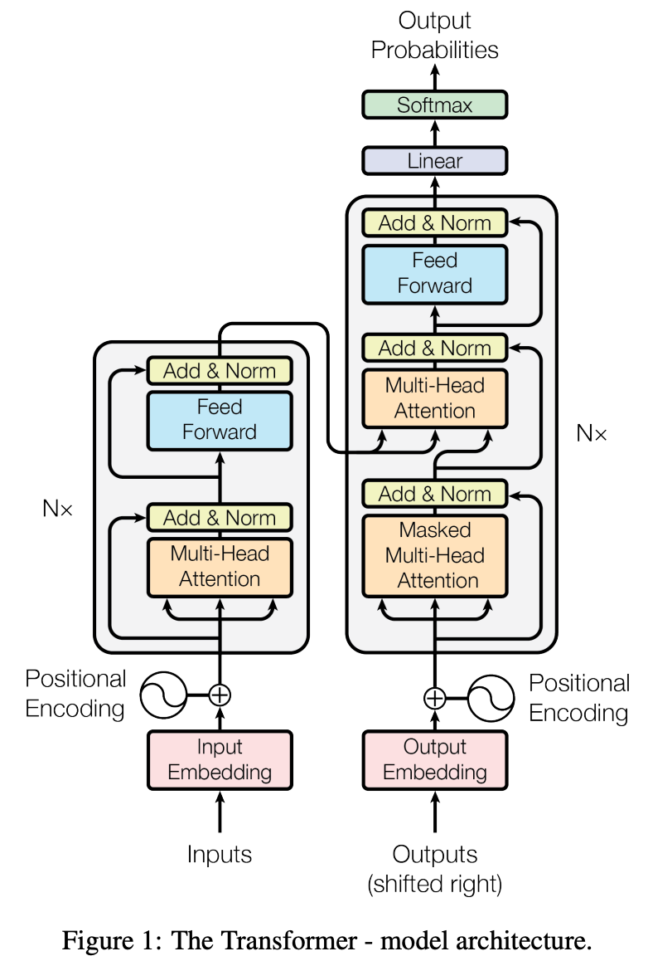
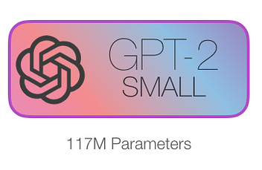


How To Achieve Aim ?
Using pre-trained language models such as Phi-2, GPT-2, Gemma-2-2b and RoBERTa wrapped with classification layer which uses Sigmoid function to get the probability for 11 labels (0 to 9th for articles, and 10th for “No article violated”).
These smaller models are advantageous because they have fewer trainable parameters, which not only reduces the computational resources required for fine-tuning but also minimizes their carbon footprint.

Slide 11
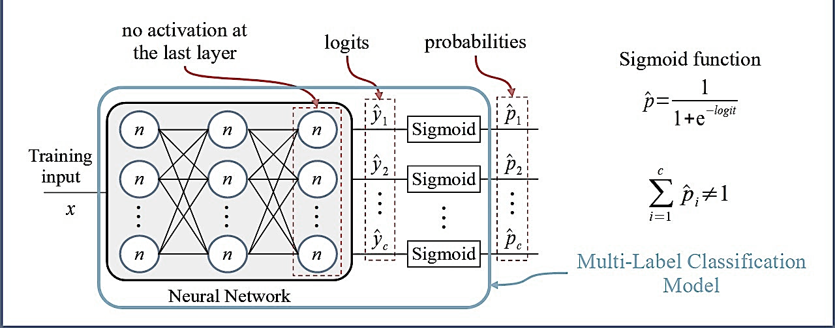
FINE-TUNING
Word
embeddings
The
1209
applicant
65748
was
2387
born
4589
.
.
.
.
.
.
claims
3876
INPUT TEXT
(Obtained by tokenizer)

Slide 12

Problem: Number of Parameters
As we are dealing with millions and billions of parameters what about computation memory ??

Slide 13
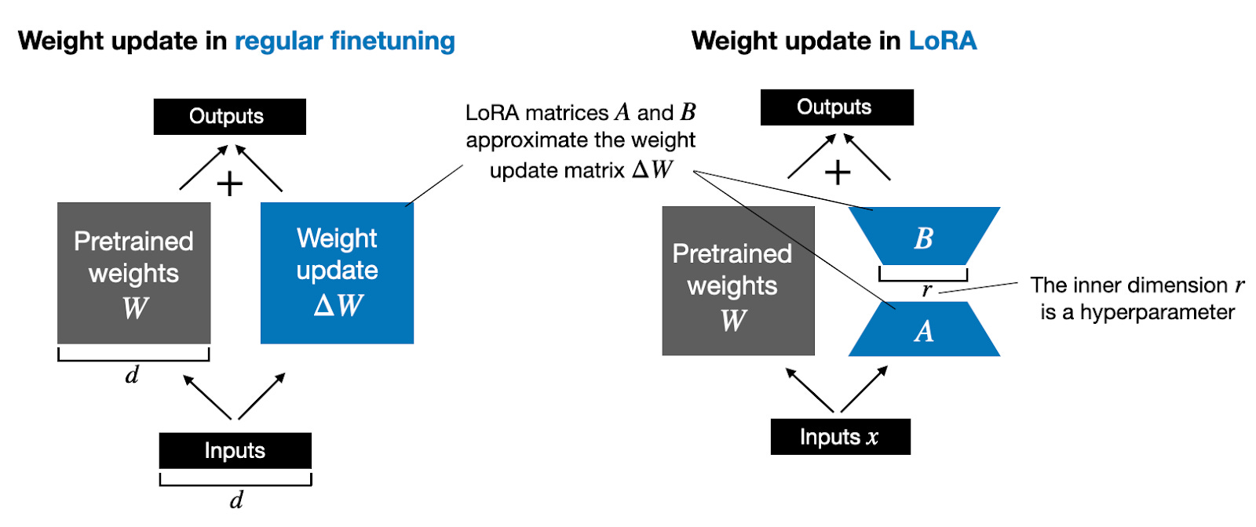
Solution: LoRa
LoRa (Low-Rank Adaptation): LoRa is a fine-tuning technique that adapts pre-trained models by introducing low-rank updates to the model's weight matrices, significantly reducing the number of parameters that need to be adjusted.
This allows for efficient training by updating only a small subset of weights, making it ideal for scenarios with limited computational resources or when targeting specific, specialized tasks.
HURRAY !!
LESS COMPUTATION MEMORY

Slide 14
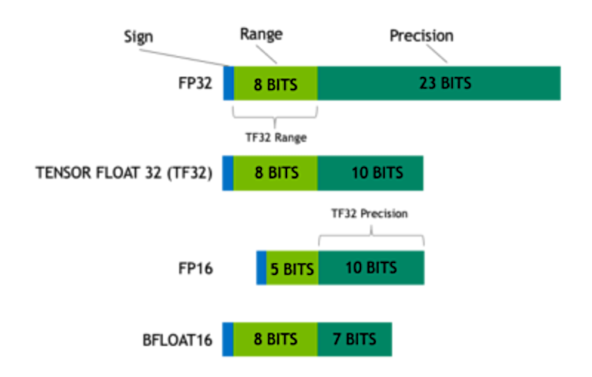
Solution: Quantized Models
It is a technique where the precision of the model’s parameters (like weights and biases) is reduced from high-precision formats (such as 32-bit or 16-bit floating-point numbers) to lower-precision formats (such as 8-bit integers).
Minimal Impact on Performance: Properly quantized models can maintain nearly the same level of performance as their high-precision counterparts while significantly reducing computational and memory overhead.
16-bit precision: (often called "half-precision") uses only 16 bits to represent a floating-point number. While this format offers less accuracy and a smaller range of values compared to 32-bit precision, it significantly reduces memory usage and computational requirements.

Slide 15

RESULTS

Slide 16
Metric for evaluation
Micro F1 Score: Micro F1 looks at all instances together, treating each prediction equally. It calculates an overall score based on the total number of correct and incorrect predictions, making it good for handling imbalanced datasets.
Macro F1 Score: Macro F1 calculates the F1 score separately for each class and then averages them. It treats each class equally, which helps in understanding how well the model performs across all different categories, especially when some classes have fewer examples.
Table for micro-f1 and macro-f1score for models
Model | max_seq_len | epochs | Micro f1 | Macro f1
GPT-2-small | 512 | 3 | 0.631 | 0.556
GPT-2-small | 1024 | 3 | 0.675 | 0.579
Phi-2 | 512 | 3 | 0.628 | 0.477
Phi-2 | 1024 | 3 | 0.636 | 0.521
RoBERTa | 512 | 6 | 0.644 | 0.6051
T5 | 512 | 3 | 0.1914 | 0.1413

Slide 17
CONCLUSION

Slide 18
Large language models (LLMs) have shown significant potential in the legal field, helping to automate tasks like case analysis, legal research, and predicting case outcomes.
The development of specialized legal LLMs, such as caseLawBERT, legalBERT, and CasualLM-7B, pre-trained on legal texts, demonstrates the growing recognition of AI's value in the legal domain.
These models enhance the accuracy and efficiency of legal tasks by understanding and processing complex legal language and context.
As the legal industry becomes more aware of AI's benefits, the adoption of these models is likely to increase, leading to more streamlined legal processes and informed decision-making.
The ongoing innovation in legal AI tools reflects a broader trend towards leveraging advanced technology to support and enhance legal expertise.

Slide 19
Q&A

